Slide 1
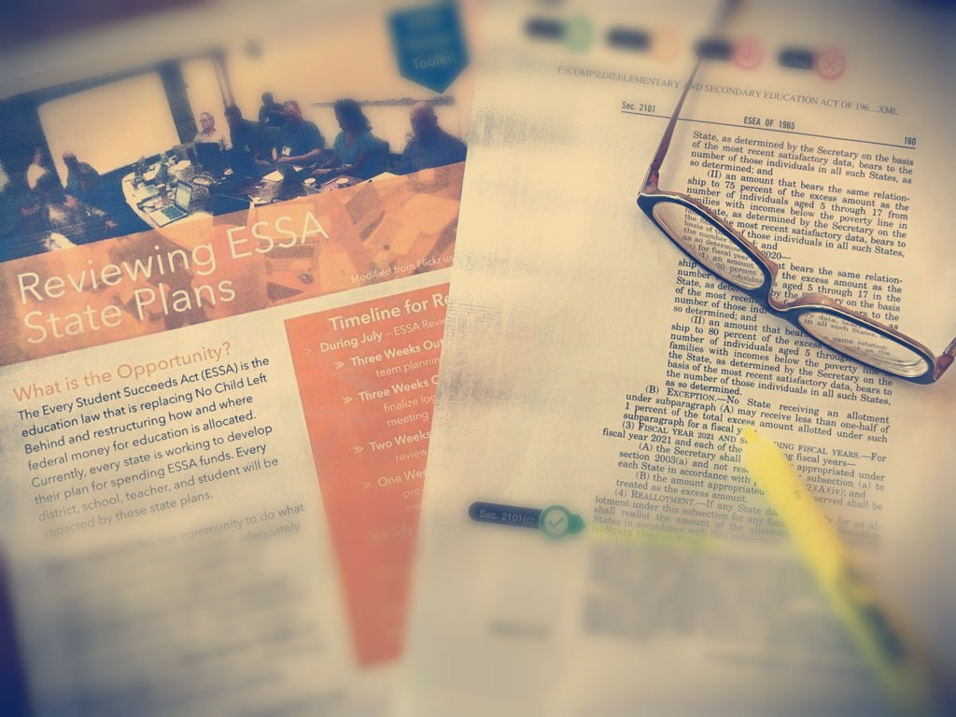
ESSA
Review
Tool
#4
ESSA Review Toolkit
July 18, 2017
Location
City, State
Review Team Meeting Agenda
Welcome and Introductions
Context
Goals and workflow for today’s meeting
Review the resources from the toolkit
Discuss Guiding Questions and Look Fors
Produce and submit a summary of our comments
Decide on next steps for our work together
Developed in partnership with the National Council of Teachers of Mathematics, Math Teachers’ Circle Network, and the Association of State Supervisors of Mathematics (2017)
http://nctm.org/essatoolkit
Notes:
Slide 1: Introduction
Before the meeting, ensure the date and location are edited appropriately. While we recommend including the footer and logos of the organizations who contributed to the development of this toolkit, meeting hosts should edit the presentation to meet their preference.

Slide 2
Welcome and Thank You
ESSA
Review
Tool
#2
Context
The Every Student Succeeds Act (ESSA) is the education law that is replacing No Child Left Behind and restructuring how and where federal money for education is allocated. Currently, every state is working to develop their plan for spending ESSA funds. Every district, school, and teacher will be impacted by these state plans.
Thank you for taking up the call to advocate for mathematics education in state ESSA plans!
Developed in partnership with the National Council of Teachers of Mathematics, Math Teachers’ Circle Network, and the Association of State Supervisors of Mathematics (2017)
http://nctm.org/essatoolkit
Notes:
Slide 2: Context

Slide 3
Goals for Today’s Meeting
ESSA
Review
Tool
#2
Goals
To produce a summary of comments that we submit to the state by the end of the meeting
To begin advocating for this work beyond just submitting comments
To identify next steps that we can take to continue to build influence for math in ESSA at the state and district levels
Developed in partnership with the National Council of Teachers of Mathematics, Math Teachers’ Circle Network, and the Association of State Supervisors of Mathematics (2017)
http://nctm.org/essatoolkit
Notes:
Slide 3: Goals

Slide 4
Workflow for Each Title Reviewed
ESSA
Review
Tool
#2
Workflow
Discuss each Guiding Question informed by the Allowable Activity Tools (1-1.5 hours)
Write up the summary of comments (1 hour)
Submit our comments and begin advocating for our work (10 minutes)
Developed in partnership with the National Council of Teachers of Mathematics, Math Teachers’ Circle Network, and the Association of State Supervisors of Mathematics (2017)
http://nctm.org/essatoolkit
Notes:
Slide 4: Workflow
The tools included in the ESSA Review Toolkit are specifically oriented toward Title II, Part B (discussed in part D.1 of state plans). However, we recommend reviewing other sections of their state plan if there are enough members of the review team.

Slide 5
Review Toolkit Resources that Can Support Our Work
ESSA
Review
Tool
#2
Resources
Reading Guide (Tool #2)
Provides overall context for Title II, Part A
Analysis Tool (Tool #3)
A guide for reading the state-level activities section of our state’s plan for Title II, Part A
Includes a list of high-leverage allowable activities
Overall and Section-Specific Guiding Questions
Allowable State Activity One-Pagers (Tools #5 - #11)
A guide designed to help focus attention during review
Context and expert recommendations
Possible ways that states might effectively address recommendations
Promising features from selected draft state plans
Note taking guide (Tool #12)
Developed in partnership with the National Council of Teachers of Mathematics, Math Teachers’ Circle Network, and the Association of State Supervisors of Mathematics (2017)
http://nctm.org/essatoolkit
Notes:
Slide 5: Resources

Slide 6
Guiding Questions
ESSA
Review
Tool
#2
Actions
Discuss each Guiding Question informed by the Allowable Activity Tools (1-1.5 hours)
Assign a note taker
Each reviewer presents his/her comments
Identify 3-4 themes to include in the summary of comments
Developed in partnership with the National Council of Teachers of Mathematics, Math Teachers’ Circle Network, and the Association of State Supervisors of Mathematics (2017)
http://nctm.org/essatoolkit
Notes:
Slide 6: Intro to Guiding Questions Discussion

Slide 7
Overarching Guiding Question #1
ESSA
Review
Tool
#2
Social Justice
To what extent does the plan propose activities that are likely to result in equitable outcomes for each and every student?
Developed in partnership with the National Council of Teachers of Mathematics, Math Teachers’ Circle Network, and the Association of State Supervisors of Mathematics (2017)
http://nctm.org/essatoolkit
Notes:
Slide 7: Social Justice

Slide 8
Overarching Guiding Question #2
ESSA
Review
Tool
#2
Systemic Thoughts & Actions
To what extent does the plan reflect a systemic approach to addressing local, district, and state needs?
Developed in partnership with the National Council of Teachers of Mathematics, Math Teachers’ Circle Network, and the Association of State Supervisors of Mathematics (2017)
http://nctm.org/essatoolkit
Notes:
Slide 8: Systemic Thoughts & Actions

Slide 9
Overarching Guiding Question #3
ESSA
Review
Tool
#2
Leadership
To what extent does the plan include mechanisms for teachers to collaboratively experience and develop leadership and to grow professionally?
Developed in partnership with the National Council of Teachers of Mathematics, Math Teachers’ Circle Network, and the Association of State Supervisors of Mathematics (2017)
http://nctm.org/essatoolkit
Notes:
Slide 9: Leadership

Slide 10
Professional Development Guiding Question #1
ESSA
Review
Tool
#2
Knowledge
To what extent does the plan prioritize professional development that is sustained, intensive, and focused on increasing knowledge of mathematics content, pedagogy, and curriculum?
Developed in partnership with the National Council of Teachers of Mathematics, Math Teachers’ Circle Network, and the Association of State Supervisors of Mathematics (2017)
http://nctm.org/essatoolkit
Notes:
Slide 10: Knowledge

Slide 11
Professional Development Guiding Question #2
ESSA
Review
Tool
#2
Instruction & Assessment
To what extent does the plan position evidence of student thinking and learning as the driver for collaborative planning and professional learning experiences?
Developed in partnership with the National Council of Teachers of Mathematics, Math Teachers’ Circle Network, and the Association of State Supervisors of Mathematics (2017)
http://nctm.org/essatoolkit
Notes:
Slide 11: Instruction & Assessment

Slide 12
Professional Development Guiding Question #3
ESSA
Review
Tool
#2
Systemic Change
To what extent does the plan include sufficient time and mechanisms for teachers to participate in collaborative professional learning opportunities that will build their capacity to implement effective teaching practices that increase student achievement?
Developed in partnership with the National Council of Teachers of Mathematics, Math Teachers’ Circle Network, and the Association of State Supervisors of Mathematics (2017)
http://nctm.org/essatoolkit
Notes:
Slide 12: Systemic Change

Slide 13
Summary of Comments
ESSA
Review
Tool
#2
Summary
Write up the summary of comments (1 hour)
Note takers write up 3-4 bullet points representing the key themes for each Guiding Question
Others work on writing a short introductory paragraph for the comments
Proofread and “sign” the comments document
Developed in partnership with the National Council of Teachers of Mathematics, Math Teachers’ Circle Network, and the Association of State Supervisors of Mathematics (2017)
http://nctm.org/essatoolkit
Notes:
Slide 13: Summary of Comments

Slide 14
Begin Advocating
ESSA
Review
Tool
#2
Summary
Submit comments and begin advocating (10 minutes)
Submit comments to the state!
Consider using the hashtags #ESSA and #MTBoS and mentioning @CCSSO, @success_STEM, @NCTM, @MathTeachCircle, and/or @StateMathLeaders, and also tweeting at your state’s Chief State School Officer and Governor.
Take a photo of review and post it on social media
Submit comments through the NCTM/Math Teachers’ Circle Network/ASSM survey at http://bit.ly/ESSA-ToolkitSurvey.
Developed in partnership with the National Council of Teachers of Mathematics, Math Teachers’ Circle Network, and the Association of State Supervisors of Mathematics (2017)
http://nctm.org/essatoolkit
Notes:
Slide 14: Submitting Comments

Slide 15
Just the Beginning
ESSA
Review
Tool
#2
Next Steps
What are some things we can do to build influence for math in ESSA at the state and district levels?
Consider letters to the editor, continuing to post on social media, sharing with our professional networks, and starting to think toward district-level plan development
How can each of us contribute to this work moving forward?
Developed in partnership with the National Council of Teachers of Mathematics, Math Teachers’ Circle Network, and the Association of State Supervisors of Mathematics (2017)
http://nctm.org/essatoolkit
Notes:
Slide 15: Submitting Comments

Slide 16
ESSA
Review
Tool
#2
ESSA
Review
Tool
#4
Thank you!
The work of reviewing state plans is tedious and often thankless. We sincerely appreciate your dedication to mathematics education and your work as a leader, a steward, and as an advocate in our field.
If you have any recommendations for how our organizations can better serve you, please let us know by completing our ESSA Toolkit Survey at http://bit.ly/ESSA-ToolkitSurvey.
Developed in partnership with the National Council of Teachers of Mathematics, Math Teachers’ Circle Network, and the Association of State Supervisors of Mathematics (2017)
http://nctm.org/essatoolkit
Notes:
Slide 16: Thank You

